Slide 1
Algebraic Bethe ansatz for the XXZ Heisenberg spin chain
Igor Salom (Institute of Physics, Belgrade)
and Nenad Manojlovic (University of Algarve, Portugal)

Slide 2
Talk outline
Introduction to algebraic Bethe ansatz
A few words on motivation
Define XXX chain problem
Introduce standard notions (R matrices, Lax operator, monodromy, transfer matrix, Bethe equations)
Solving ABA
Contemporary research generalizations
XXZ chain interaction anisotropy
Nontrivial boundary conditions
How do we solve this?
Announce another integrable system – Gaudin model - that Prof. Manojlovic is going to discuss in the next talk

Slide 3
Motivation?
So few problems that we can exactly solve
Any such is precious
Some models have more or less natural potential application
Explains dominant magnetic behavior
Related to conformal field theories In 2 dimensions
Expected to provide insights to realistic problems

Slide 4
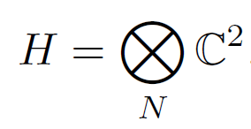
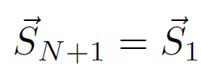
Basic problem – spin chain
Heisenberg spin chain Hamiltonian (nearest neighbor interaction):
Solve = find energies, wave functions, other conserved quantities

Slide 5
Coordinate Bethe ansatz
90 years old approach:
Does solve the main problem, but not allowing easy generalizations
We will not follow this approach

Slide 6
Algebraic Bethe Ansatz (ABA)
Introduce additional auxiliary space and a “Lax operator”:

Slide 7
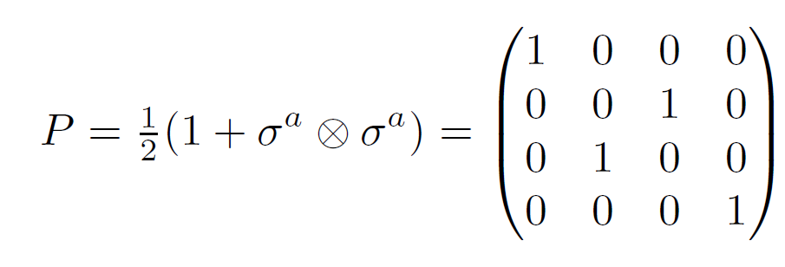
Relation to permutation operator
Lax operator can be written as:
Where P is permutation operator:

Slide 8
How Lax operators commute?
Consider:
where:
This “RLL” relation or “fundamental commutation relation” can here be confirmed by using:
?

Slide 9
R matrices
These R matrices satisfy the quantum Yang-Baxter equation:
Which can be seen to follow from RLL relation, since:
while also:

Slide 10
Monodromy
Now we define “Monodromy”, that acts on the entire chain:
That can be seen as a 2x2 matrix whose elements are operators on the basic Hilbert space:
From RLL we find how T-s commute, i.e. RTT:

Slide 11
Transfer matrix
The trace:
due to
commutes for different values of the parameter:

Slide 12
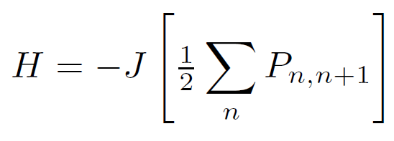
Why is this important?
We have families of mutually commuting operators, e.g. obtained from power series expansion. And one of such operators is the Hamiltonian! From:
one obtains:
which is proportional to the Hamiltonian:
also:

Slide 13
Solving the transfer matrix eigenproblem
If we know eigenvalues of the transfer matrix t(u), we know values of all conserved quantities!
First we show that is an eigenstate:
thus:
also we note:

Slide 14
The rest of eigenvectors?
We show that these are obtained by action of B operators.
First we neeed “commutation” relations:

Slide 15
From the commutation relations…
If we define vectors:
we obtain “off-shell” action:
unwanted terms
= 0
eigenvalue
Bethe equations

Slide 16
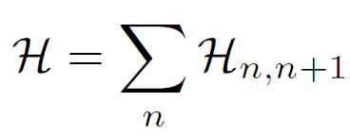
But the approach is far more general!
Each R matrix satisfying Yang-Baxter equation defines an integrable spin chain!
If and
It is proved following the same procedure:
Yet, it is not easy to solve the t eigenproblem

Slide 17
Research generalizations
Interaction does not have to be isotropic
Nonperiodic, more general boundary conditions?
Extension to long range interaction (Gaudin model)?
Find the Bethe vectors and the off-shell action
XXZ chain
XYZ chain

Slide 18
XXZ chain
R matrix
Arbitrary spin:
U_{q}(sl(2))
generators

Slide 19
A few usual steps&relations…
Now:

Slide 20
Nontrivial boundary conditions
Introduce 2x2 matrices K⁺ and K⁻ that parameterize boundary conditions
Following Sklyanin, these must satisfy “reflection” equations:

Slide 21
New monodromy matrix
It incorporates boundary conditions:
where:
satisfying

Slide 22
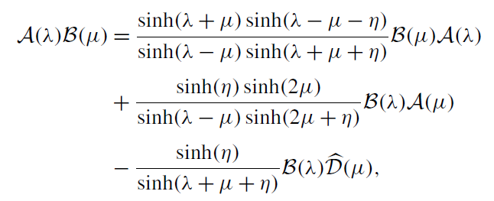
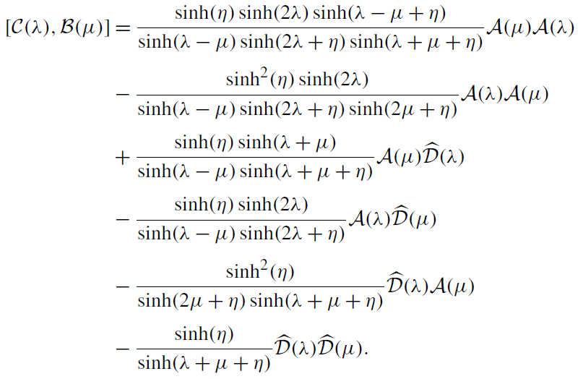
Commutation relations

Slide 23
Transfer matrix
The transfer matrix is now constructed as:
and corresponds to Hamiltonian:
XXZ anisotropy
nontrivial boundary terms

Slide 24
Finding Bethe vectors - vacuum
Start with vacuum:
where and we set φ=0

Slide 25
First order excitation
One magnon excitation vector:
eigenvalue
unwanted terms
Bethe equations

Slide 26
However, there is a freedom…
Due to the following relation:
There is actually a whole class of solutions, satisfying identical off-shell equation:
This is a generic feature, we don’t know that was discussed before!

Slide 27
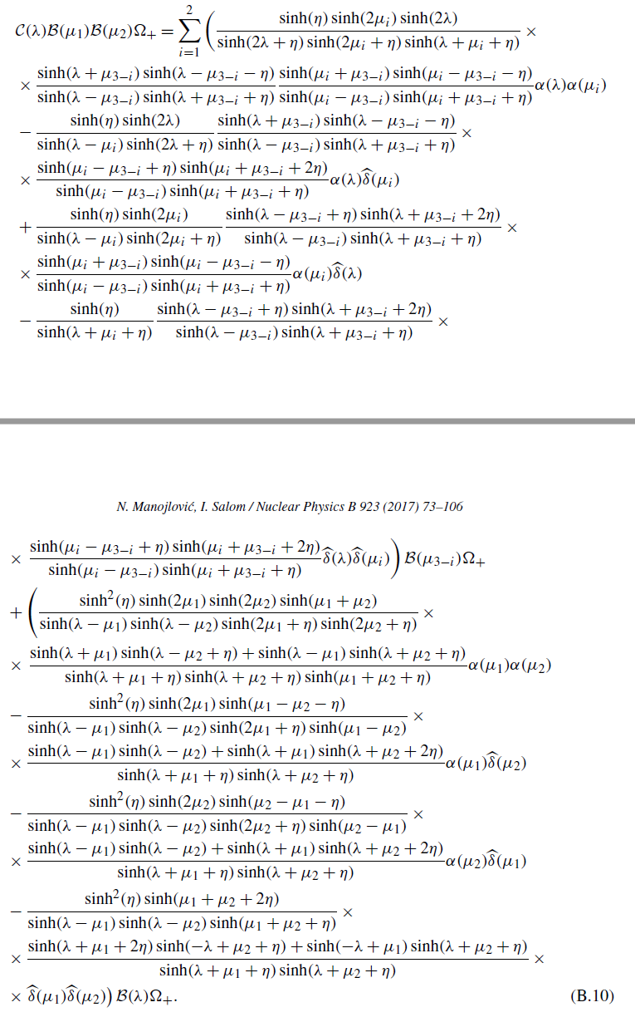
Second order excitation
One of intermediary steps

Slide 28
It satisfies off-shell equation:

Slide 29
But also does:
which is a consequence of identities:

Slide 30
General solution

Slide 31
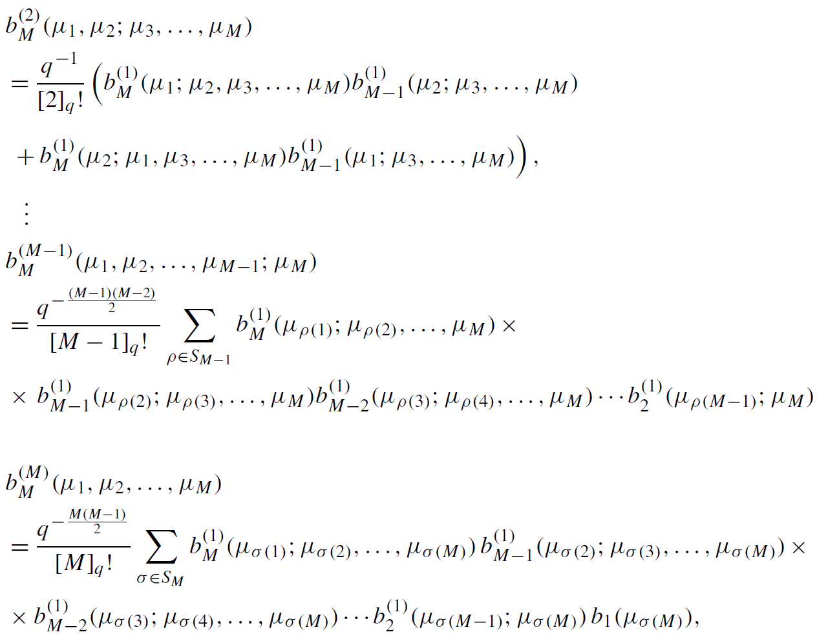
…

Slide 32
Off shell action:

Slide 33
Conclusion
We illustrated the ABA method
Following that approach, we have solved a spin-chain model with anisotropy and non-periodic boundary condition
We pointed out the degrees of freedom that appear in off-shell solutions
We set up the stage to derive another model, of long range interactions – Gaudin model…

Slide 34
Thank you.

Slide 35
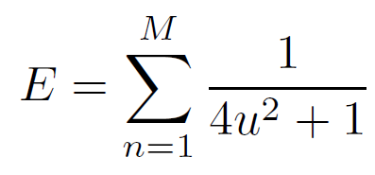
Connection with physical entities
Rapidities u_{i} are related to momenta of “magnons”
And the formula for energy:

