Slide 1
The Cosmological Constant Problem
(and its sequester)
Tony Padilla
University of Nottingham

Slide 2
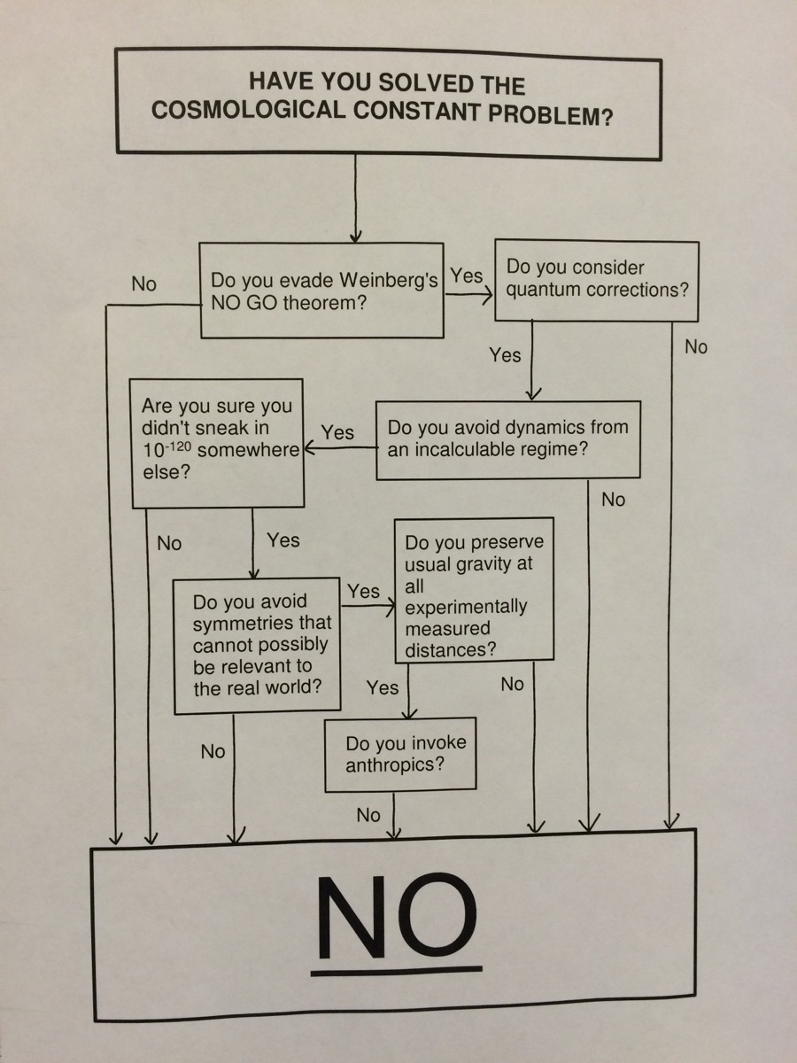
McCullen’s no go theorem
McCullen Sandora, 2016

Slide 3
“Sequestering the Standard Model Vacuum Energy” Phys.Rev.Lett. 112 (2014) no.9, 091304
“Vacuum Energy Sequestering: The Framework and Its Cosmological Consequences” Phys.Rev. D90 (2014) no.8, 084023,
“Sequestration of Vacuum Energy and the End of the Universe” Phys.Rev.Lett. 114 (2015) no.10, 101302
“Manifestly Local Theory of Vacuum Energy Sequestering” Phys.Rev.Lett. 116 (2016) no.5, 051302
“Sequestering effects on and of vacuum decay” Phys.Rev. D94 (2016) no.2, 025022
“Vacuum Energy Sequestering and Graviton Loops” Phys.Rev.Lett. 118 (2017) no.6, 061303
“An Etude on Global Vacuum Energy Sequester “ arXiv:1705.08950
“Obstructions to self-tuning and possible ways around“ arXiv:1706.04778
Collaborators: Nemanja Kaloper, Guido D’Amico, Florian Niedermann,
David Stefanyszyn, Alexander Westphal, George Zahariade

Slide 4
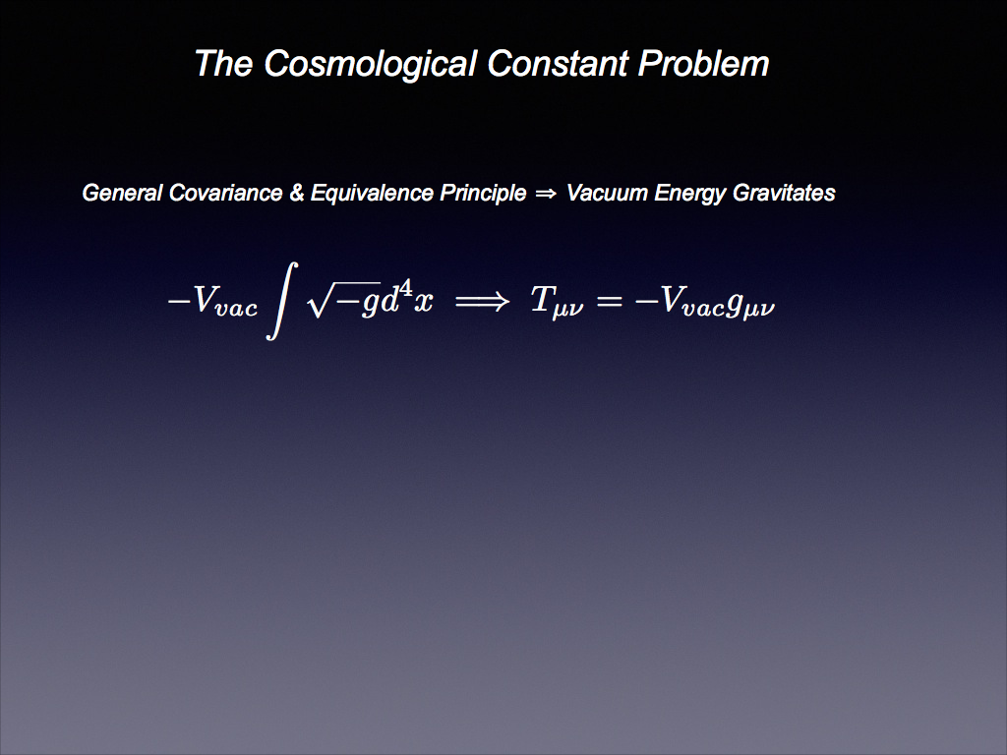

Slide 5
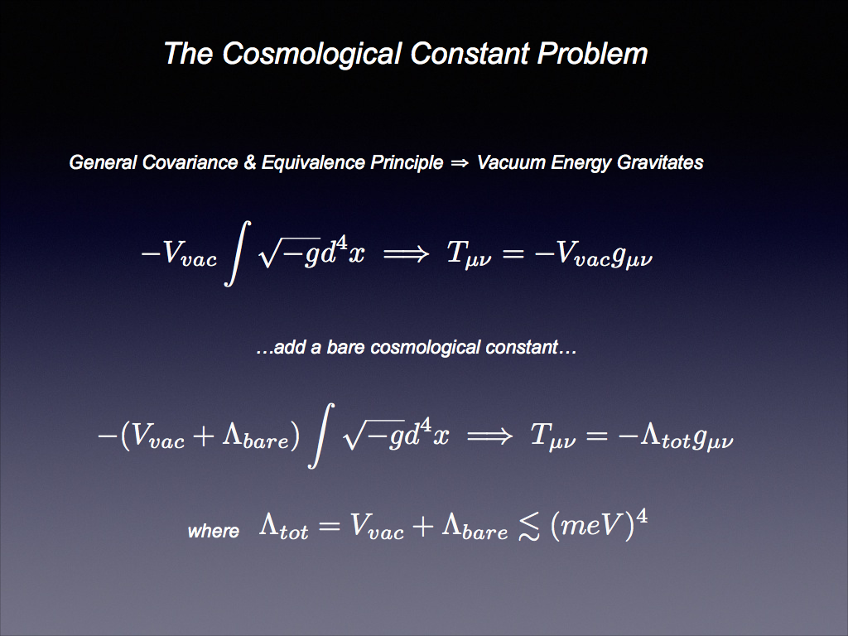

Slide 6
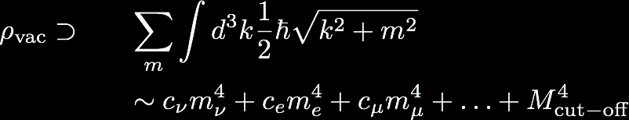
Estimating the vacuum energy
=
+
+
+ …..
+ vacuum loops involving virtual gravitons
+ counterterms

Slide 7







Quantum Gravity cut-off
fine tuning to 120 decimal places
SUSY cut-off
fine tuning to 60 decimal places
EW phase transition
fine tuning to 56 decimal places
QCD phase transition
muon
fine tuning to 44 decimal places
electron
fine tuning to 36 decimal places
observed value

Slide 8
Contrast to electron mass
electron mass, Δm ~ mlog(Mcutoff/m)
protected by chiral symmetry in massless
limit

Slide 9
Electron mass & vacuum are both UV sensitive — cannot be predicted in EFT, must be measured!
Electron mass is only mildly
sensitive to unknown UV
NATURAL
Vacuum energy is extremely
sensitive to unknown UV
UNNATURAL
naturalness ensures that low energy EFTs agree on
low energy couplings.

Slide 10
How can we make the cosmological constant
radiatively stable?
Within particle physics, SUSY would do the job, but not in a way that is compatible with pheno.
Look to gravity:
perhaps the radiative corrections are there, but they simply don’t gravitate.

Slide 11
Sequestering the Standard Model Vacuum Energy
Nemanja Kaloper, Antonio Padilla.
Phys.Rev.Lett. 112 (2014) no.9, 091304
Global Vacuum Energy Sequester

Slide 12


Introduce global dynamical variables: Λ, λ
Λ is the CC counterterm
λ sets hierarchy between
matter scales & Planck mass

Slide 13
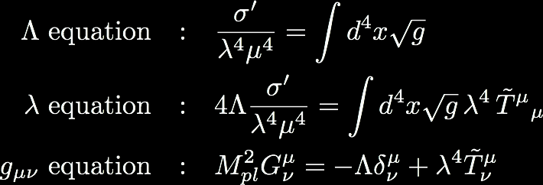


Equations of motion

Slide 14
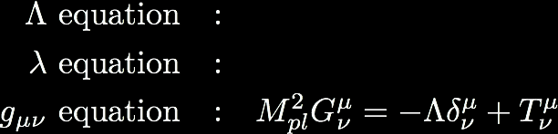

Equations of motion
space-time
average

Slide 15



Slide 16


Slide 17
Vacuum energy drops out at each and every loop order
No hidden equations — this is everything!
Residual CC is radiatively stable, value should be measured

Slide 18




Symmetries?
Approximate scaling symmetry
Approximate shift symmetry
conformal limit, vanishing λ

Slide 19
An Etude on Global Vacuum Energy Sequester
Guido D'Amico, Nemanja Kaloper, Antonio Padilla, David Stefanyszyn , Alexander Westphal George Zahariade
e-Print: arXiv:1705.08950
An Etude …

Slide 20


Duality symmetric string theory and the cosmological constant problem
Arkady A. Tseytlin
Phys.Rev.Lett. 66 (1991) 545-548
Tseytlin’s original idea ….
higher dim operators

Slide 21



In QFT, powers of hbar (generically) count loops
Tseytlin introduces an effective hbar
proportional to spacetime volume, , so….
vacuum energy loops not cancelled

Slide 22




VES fixes this by exploiting universality of matter coupling, eg
now all matter loop corrections scale as

Slide 23
A Nonlocal Approach to the Cosmological Constant Problem
Sean M. Carroll, Grant N. Remmen
Phys.Rev. D95 (2017) no.12, 123504
Carroll & Remmen’s recent idea ….
Global variable η is originates as magnetic dual of a 4 form field, H
Dual of the 4 form F acts like the CC counterterm
Claim: Global constraint from η … forces action to vanish … forcing CC counterterm to cancel radiative corrections

Slide 24
CC counterterm cannot adjust if
it is an integration constant, i.e. fixed by boundary condition
it stems from a quantised 4 form (in presence of membrane sources)
OK, so assume CC counterterm can adjust i.e. not fixed by BCs, there are no membrane sources
Are we good then?
No!!
- Effective hbar is proportional to η, so loops will spoil the constraint

Slide 25

Can fix this theory by moving η
Improved version….
places global constraint on geometry (as opposed to geometry + radiatively unstable matter)
is just a hybrid of global VES and local VES (see later)

Slide 26



Global VES in “Jordan frame”
Vary over metric and constants κ and Λ
κ variation yields a global constraint on R, Λ adjusts accordingly

Slide 27
Manifestly Local Theory of Vacuum Energy Sequestering
Nemanja Kaloper,Antonio Padilla, David Stefanyszyn , George Zahariade
Phys.Rev.Lett. 116 (2016) no.5, 051302
Local Vacuum Energy Sequester

Slide 28

Why bother?
Consistency with QM requires action to be additive
SAC=SAB+SBC
x1
xN-1
A
B
x2

Slide 29
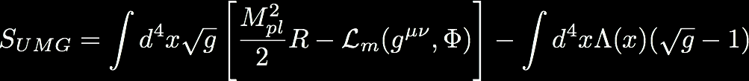
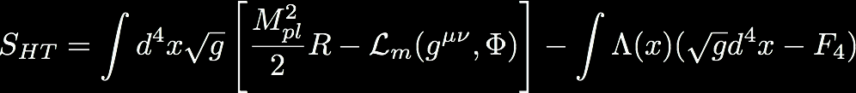
Hint: UMG a la Henneaux & Teitelboim
non-gravitating but breaks diffs
alternative measure: the 4 form
retains diffs
does not gravitate
exact 4 form F4=dA3 forces constant Λ

Slide 30

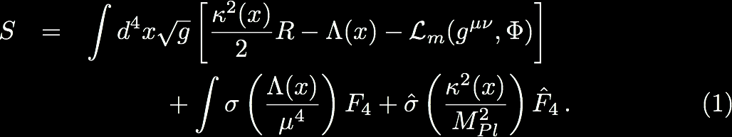
Local VES

Slide 31
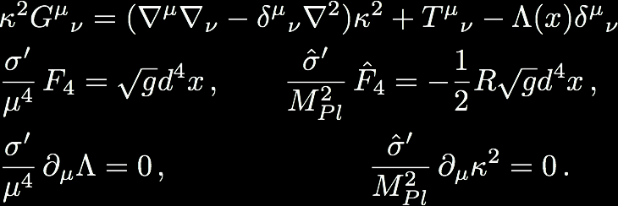


radiatively stable
constant

Slide 32


Is
radiatively stable?
Effect of vacuum loops:
smooth functions
μ > MUV
Mpl > MUV
geometric, IR quantities, not UV sensitive

Slide 33



Global trace equations
GR
fixed by
assumption
Sequester
fixed by
ratio of fluxes

Slide 34
Key points
Λ is sink for vacuum energy, channelled there by non-gravitating 4 forms
Works to any order in matter loops — gravity loops on the other hand….
Equivalence Principle violated GLOBALLY — local theory is GR, Weinberg no go evaded
Residual CC is radiatively stable— like any relevant coupling, should be measured.

Slide 35
Obstructions to self-tuning and possible ways around
Florian Niedermann, Antonio Padilla
arXiv:1706.04778
And finally, an aside on self-tuning …

Slide 36
How can we make the cosmological constant
radiatively stable?
Within particle physics, SUSY would do the job, but not in a way that is compatible with pheno.
Look to gravity:
perhaps the radiative corrections are there, but they simply don’t gravitate.

Slide 37
Self-tuning :
“admits Minkowski solution for any value of vacuum energy”
Weinberg makes assumptions e.g.
local 4D effective theory
All fields are Poincare invariant
Relax these assumptions and self-tuning can be possible e.g.
branes in 6D
Fab Four
VES
But
6D models cannot recover 4D phenomenology without spoiling the self-tuning
Fab Four has a light scalar, bad for pheno.
many other models run into problems with ghosts, singularities etc

Slide 38
General approach to seek out consistent field theoretic completions of self-tuning
use standard Kallen Lehmann spectral representation to describe generic exchange amplitudes
impose unitarity and Lorentz invariance
require self-tuning of long wavelength sources
require closeness to GR for short wavelength sources.

Slide 39
The AdS loop hole
Result generalises to dS but not AdS … can find explicit examples of AdS self-tuning that tick every box.
The VES loop hole
VES does not admit a standard KL spectral representation in terms of canonical free-field propagators…it decapitates!

Slide 40



Decapitation
Decapitating tadpoles
Allan Adams, John McGreevy, Eva Silverstein
hep-th/0209226
x
vs
divergence + counterterm=0
divergence + guillotine=0

Slide 41
GR
single massless
graviton
massless graviton
VES
massless scalar
massless graviton
Fab Four
massless ghost that gets decaptitated at vanishing k
massless scalar

Slide 42
Vacuum energy sequestering
is a new mechanism through which loop corrections to vacuum energy can be rendered gravitationally harmless
is an effective field theory and, in keeping with standard ideas behind renormalisation, makes no prediction for precise value of the CC, rather
— it should be measured
— it’s value is only mildly sensitive to the
details of the unknown UV
….. just like the mass of electron.
a new way to tackle problems of naturalness
LOTS MORE EXCITING DEVELOPMENTS ON THE WAY.
STAY TUNED!

Slide 43
Back up slides

Slide 44
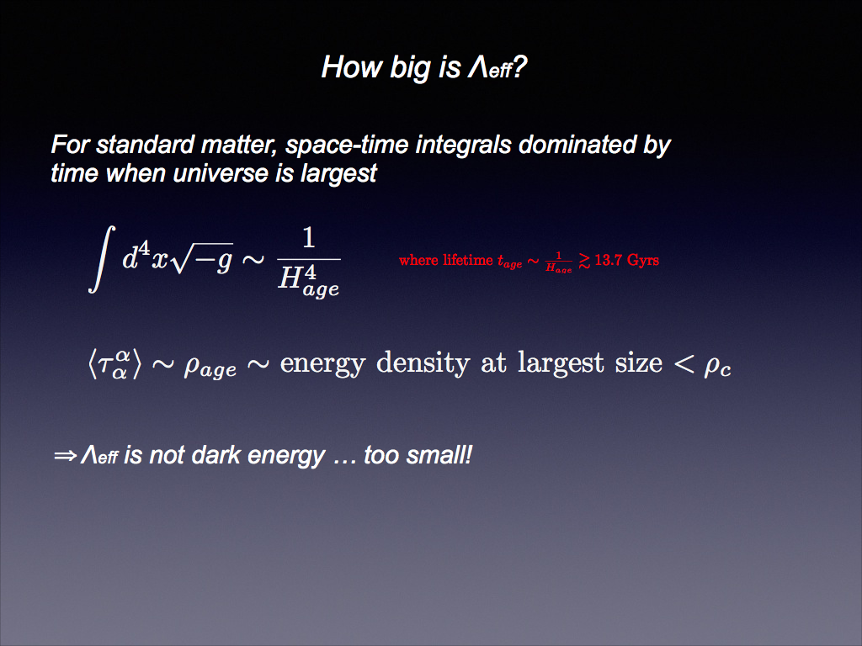

Slide 45
Observational consequences?

Slide 46
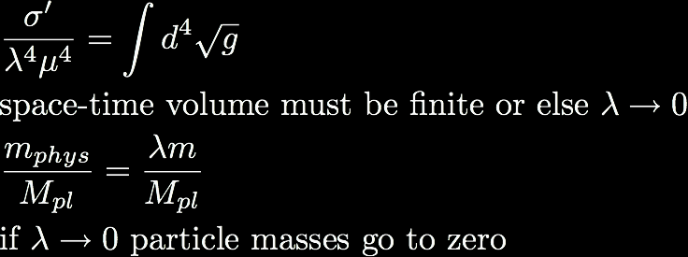
Universe has finite spacetime volume
Ends in a crunch
circles in the sky?
possible correlation between 1+w and Ωk
w=-1 is transient
Ωk>0

Slide 47


Weinberg No Go
Assume translation invariant solution for ANY vacuum energy:

Slide 48

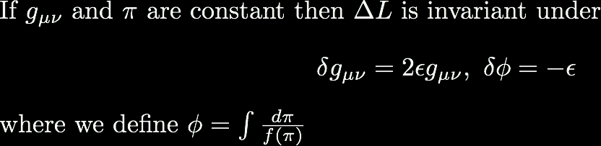

Slide 49




Recall
So translation invariant EOMs give
Fine tuning
Scale invariance

Slide 50
Phase transitions?

Slide 51



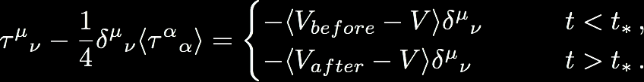

Sequestering works best in domains that dominate spacetime volume
For an early transition….
short burst of inflation in build up to a transition

Slide 52

CDL bubbles
Sequestering works best in near Minkowski vacua
tunnelling rates
from ds to Minkowski - generically enhanced compared wrt GR
from Minkowski to AdS — generically suppressed wrt GR

Slide 53

The
Global
Sequestering

Slide 54



a globally adjustable CC counterterm
a second global variable for constraining the global geometry
S1 and S2 should have no variation wrt SM fields or metric, g
e.g:
a constant
a 4 form field strength, F=dA
∫G ^G, where G=dB is a 2 form field strength
.
S1 should not vanish on shell (to avoid unphysical constraint on spacetime volume)
Sg chosen
so as not to screw up gravitational phenomenology
so as to yield a constraint on the scale dependent part of the geometry
e.g: Einstein-Hilbert, Gauss-Bonnet

Slide 55
Graviton loops?

Slide 56

The Hybrid
Start with local VES
^
Integrate out Λ and A
where κ is now global and function ε is related to Legendre transform of σ
compare with

Slide 57
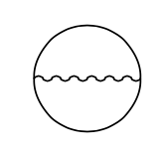


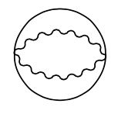


Vacuum Energy Sequestering and Graviton Loops
Nemanja Kaloper , Antonio Padilla
Phys.Rev.Lett. 118 (2017) no.6, 061303
What about graviton loops?
these introduce new κ dependence in renormalised 1PI effective potential
Screws up the κ EoM - no longer able to constrain R at large wavelength with four form fluxes

Slide 58


Variation wrt to rigid κ protects
NOTHING
Ricci scalar at long wavelength

Slide 59

Two key insights
to avoid undesirable corrections to the effective potential, need an
unbroken shift symmetry
any curvature invariant that is NOT scale invariant can be used to constrain R at large wavelength

Slide 60


Gauss-Bonnet integral anchored in place by four forms
Weyl tensor
Vacuum energy drops out

Slide 61
The End

Slide 62

COLLAPSE TRIGGER
=
DARK ENERGY
Linear potential V=m³φ
form protected by shift symmetry, size of m³ technically natural
If φin >Mpl, then when scalar dominates, does so in SLOW ROLL until collapse time

Slide 63
Radiatively stable choice of collapse time?
Yes, thanks to m³
Radiatively stable choice of φin?
Yes, thanks to shift symmetry
But its not even a “choice”.... <R>=0 picks out precisely those solutions with φin >Mpl !!!!!!!

Slide 64
WHY NOW?
Because the end is nigh!!!
Why is it nigh?
Because the radiatively stable parameter m³~ Mpl H0²
Prediction:
1+w ~ ΩΚ²

