Slide 1
Three quarks
Two potentials
One coordinate system
James Leech – MPhys student, University of St Andrews, UK
Is the effective three-quark confinement potential best described by the Y string or the Delta string?

Slide 2
Contents
Introduction
  Motivation
  Recent calculations by Koma & Koma
Hyperspherical co-ordinates
  Definition
  Dynamical symmetry of the Y string potential
Analysis of Koma 2017 data
  Fitting procedure
  Results
Summary & Conclusions

Slide 3
Motivation
Three quark confinement potential is not understood well.
New calculations of three-quark potential by Koma & Koma – March 2017.
Question: Is the three-quark effective potential described by?
Or
Y-string potential?
120 degree angles.
Sum of lengths to Fermat point, x_{0.}
Delta-string potential?
Sum of length of sides.

Slide 4
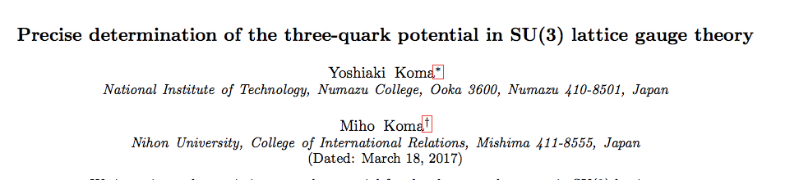
Koma & Koma Method
Koma & Koma data points:
Isosceles triangles
Right-angled triangles
Co-linear
24 x 24 x 24

Slide 5
Koma & Koma results:
Inconclusive

Slide 6
Hyper-spherical Coordinates
Three body system
(x₁, y₁, z₁, x₂, y₂, z₂, x₃, y₃, z₃)
(Angle 1, Angle 2, Size)

Slide 7
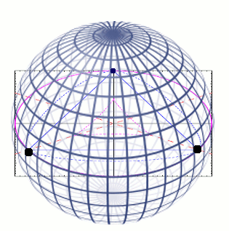

Hyper-spherical Coordinates
Relative vectors – rho, lambda:
Hyper-angles – point on unit sphere surface:
Hyper-radius – size:
$$R^{2}={\vec{ρ}}^{2}+{\vec{λ}}^{2}$$

Slide 8
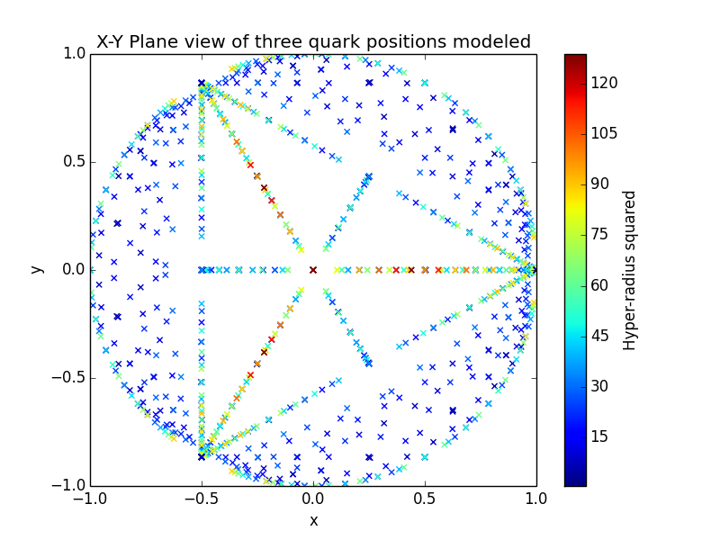
Koma data – Hyper-radius as a function of hyper-angles:
Right-angled triangle line
Equilateral
Isosceles line
Co-linear (equator of sphere)

Slide 9
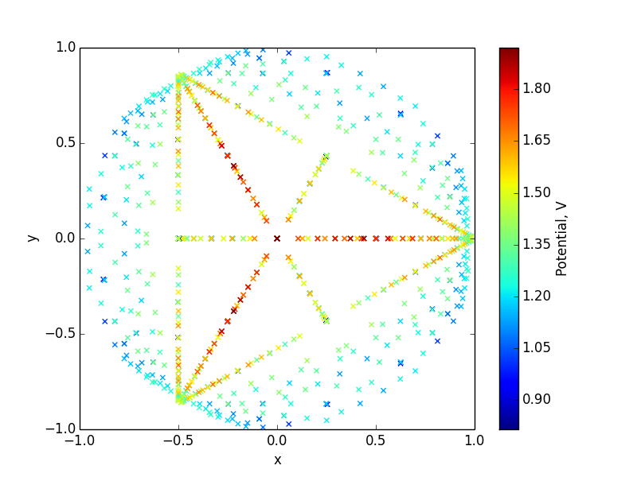
Hyper-spherical Coordinates
Table of Koma & Koma data:
Koma & Koma data – Potential V as a function of hyper-angles:

Slide 10
Dynamical symmetry of the Y potential
Y potential on plane:
Koma & Koma potential on plane:
Equipotential circle
Symmetry breaks outside blue-dotted line
No good circles to compare with

Slide 11
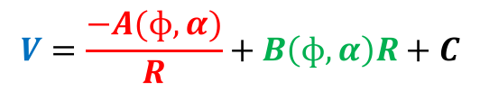
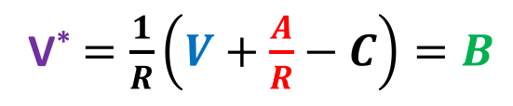
Analysis of Koma 2017 data – fitting ansatz:
Aim: Remove coulomb interaction and hyper-radial dependence.
Say potential takes form:
Koma & Koma data potential
Strong-force coulomb interaction
Inter-quark potential
$$V=\frac{−A(ɸ,α)}{R}+B\left(ɸ,α\right)R+C$$
Fix ɸ, α.
Least-square fitting for A, B, C.
Theoretical A known.
Define K: Ratio of fitted A and theoretical A – want K independent of ɸ, α.
If K constant, can define:
V* $=\frac{1}{R}\left(V+\frac{A}{R}−C\right)=B$
V* independent of Hyper-radius.

Slide 12
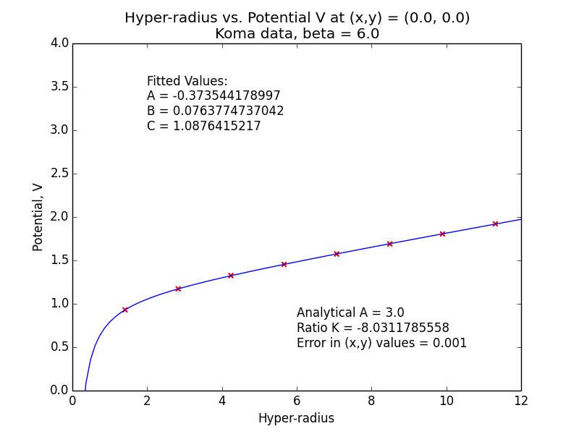
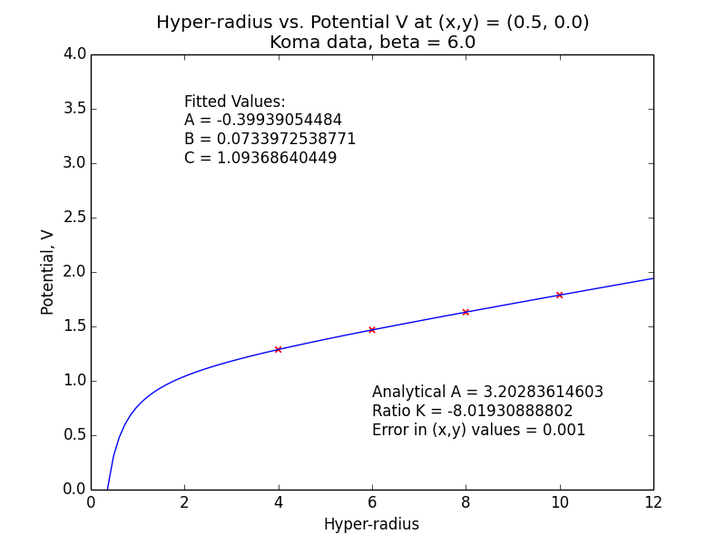
Is K constant?
V against Hyper-radius for two points:
Origin
(-0.5, 0.0)
% Difference in K: 0.1477948435%
K very nearly constant
Notes:
Koma did this too

Slide 13
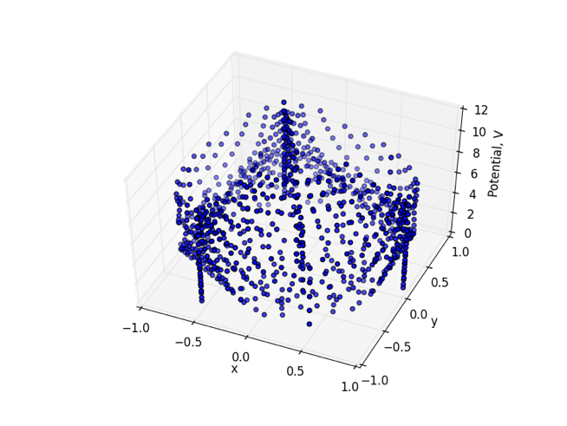
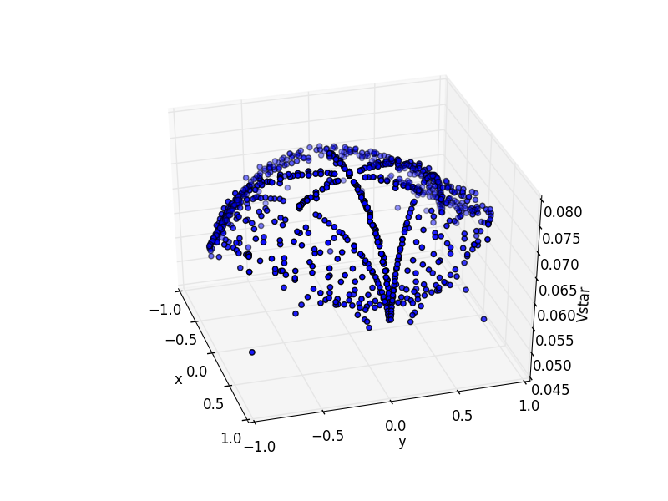
Fitting Procedure
Data points (x, y, V)
V* potential (x, y, V*) – depends only on hyper-angles

Slide 14
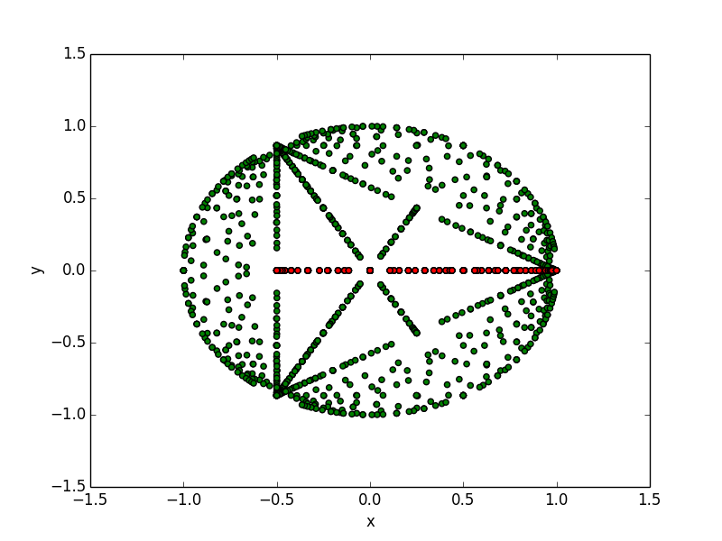
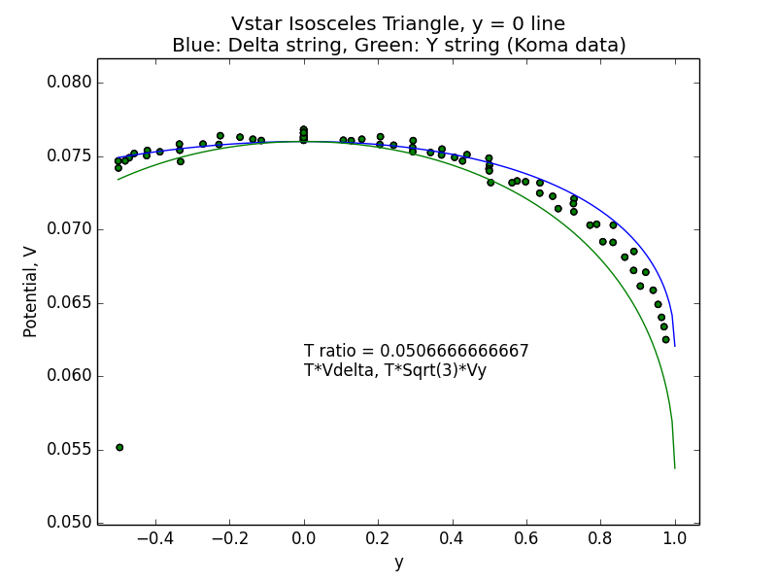
Results
V* along highlighted line
Delta
Y
Isosceles triangles
Some combination of Y & Delta
Notes:
Clear taking slice. Clear y and delta lines. Ready answer to why points lie outside lines – list of possible reasons.
K not being constant.
Error in data.
Some remaining HR dependence – take only large to avoid coulomb.

Slide 15
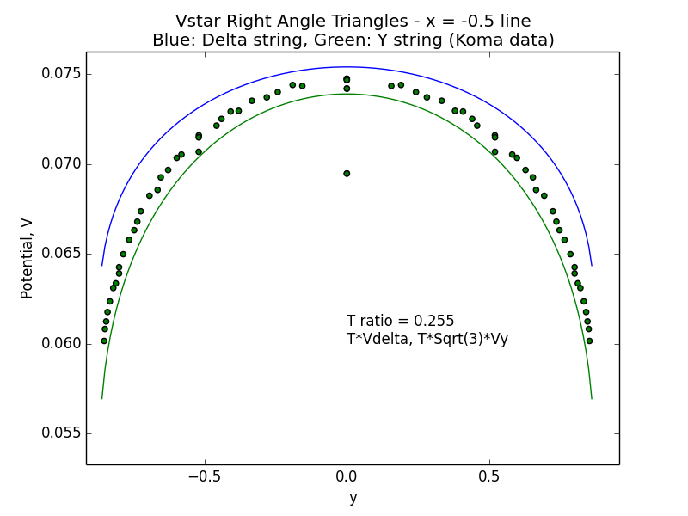
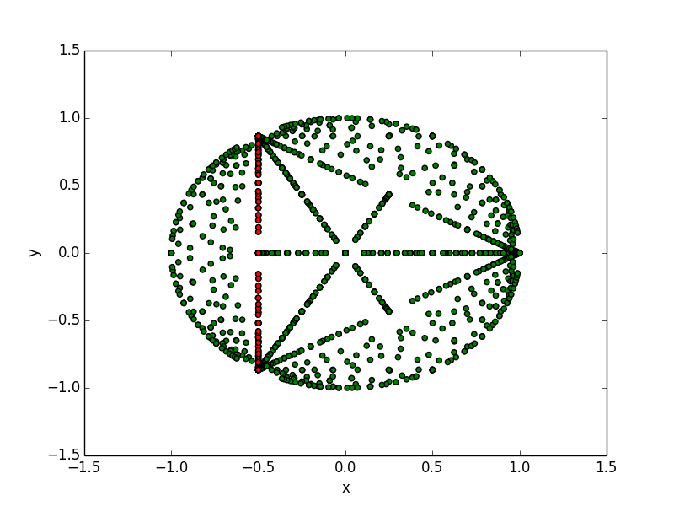
Results
V* along highlighted line
Delta
Y
Right-angled triangles
Some combination of Y & Delta

Slide 16
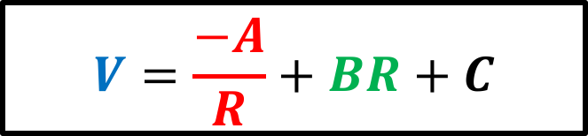
Summary & Conclusions:
Hyper-spherical coordinates are useful for visualising QCD datapoints
Insufficient data points near origin to compare data with Y potential by symmetry.
Instead applied a fitting ansatz.
Results from fitting across isosceles and right-angled triangle lines suggested some combination of Y and Delta.
$$V=\frac{−A}{R}+BR+C$$

Slide 17
Summary & Conclusions:
Inconclusive
…but we know where to look next.

