Slide 1
Non-Riemannian geometry, Born–Infeld models and trace free gravitational equations
Diego Julio Cirilo-Lombardo
Non-Riemannian generalization of the standard Born–Infeld (BI) Lagrangian is introduced and analyzed from a theory of gravitation with dynamical torsion field. The field equations derived from the proposed action lead to a trace free gravitational equation (non-Riemanniananalog to the trace free equation (TFE) from Finkelstein et al., 2001;Ellis et al., 2011;Ellis, 2014) and the field equations for the torsion respectively. In this theoretical context, the fundamental constants arise all from the same geometry through geometrical invariant quantities (as from the curvature R). New results involving generation of primordial magnetic fields and the link with leptogenesis and baryogenesis are presented and possible explanations given. The physically admissible matter fields can be introduced in the model via the torsion vector hμ. Such fields include some dark matter candidates such as axion, right neutrinos and Majorana and moreover, physical observables as vorticity can be included in the same way. From a new wormhole solution in a cosmological spacetime with torsion we also show that the primordial cosmic magnetic fields can originate from hμ with the axion field (that is contained in hμ) the responsible to control the dynamics and stability of the cosmic magnetic field but not the magnetogenesis itself. As we pointed out before (Cirilo-Lombardo, 2017), the analysisof Grand Unified Theories (GUT) in the context of this model indicates that the group manifold candidates are based in SO(10), SU(5)or some exceptional groups as E(6), E(7), etc.
Journal of High Energy Astrophysics 16 (2017) 1–14 Int.J.Geom.Meth.Mod.Phys. 14 (2017) no.07, 1750108

Slide 2
1. Introduction
2. Basis of the metrical-affine geometry
3. Geometrical Lagrangians: the generalized Born–Infeld action
4. Field equations
5. Emergent trace free gravitational equations
6. On the constancy of G
7. The vector hμ and the energy–matter interpretation
8. Physical consequences
9. Torsion, axion electrodynamics vs. Chern Simons theory
10. Magnetic helicity generation and cosmic torsion field
11. Discussion and perspectives

Slide 3
INTRODUCTION
1) The drawback of the Einstein GR (General Relativity) equations is the RHS: Rαβ−gαβR/2 =κTαβ with the symmetric tensor (non-geometrical) κTαβ that introduces heuristically the energy–momentum distribution
2) Similar troubles is obtained from Einstein–Hilbert action in which the unimodular condition:−detgμν=1 is also imposed from the very beginning The resulting field equations correspond to the trace-less Einstein equations and can be shown that they are equivalent to the full Einstein equations with the cosmological constant term , where enters as an integration constant and the equivalence between unimodular gravity and general relativity is given by the arbitrary value of lamda
3) The fact that the determinant of the metric is fixed has clearly profound consequences on the structure of given theory. First of all, it reduces the full group of diffeomorphisms to invariance under the group of unimodular general coordinate transformations which are transformations that leave the determinant of the metric unchanged.

Slide 4
4) Similar thing happens in the non-Riemannian case, where the corresponding affine geometrical structure induces naturally the following constraint: K/ g = constant. This natural constraint impose a condition (ratio) between both basic tensors through their determinants: the metric determinant g and the fundamental one K (in the sense of a nonsymmetric theory that contains the antisymmetric structures), independently of the precise functional form of K or g.
5) In this work our starting point was precisely the last one, where a metric affine structure in the space–time manifold will be considered. We will also show that trace free gravitational equations can be naturally obtained when the Lagrangian function (geometrical action) is taken as a measure involving a particular combination of the fundamental tensors of the geometry:
with the (0, 2) tensors gμν , fμν, Rμν : the symmetric metric, the antisymmetric one (that acts as potential of the torsion field) and the generalized Ricci tensor (proper of the non-Riemannian geometry).
6) The three tensors are related with a Clifford structure of the tangent space where the explicit choice for f (gμν , fμν,Rμν ) is given
7) This type of Lagrangians, because are non-Riemannian generalizations of the well known Nambu–Goto and Born–Infeld (BI) ones, can be physically and geometrically analyzed.
8) Due the pure geometrical structure of the theory, induced energy momentum tensors and fundamental constants (actually functions) emerge naturally.
9) Consequently, this fact allows the physical realization of the Mach principle

Slide 5
METRICAL AFFINE GEOMETRY: BASICS
The starting point is a hypercomplex construction of the (metric compatible) spacetime manifold (Cirilo-Lombardo, 2015;McInnes, 1984)
where for each point p ∈M there exists a local affine space A.
The connection over A, Г, define a generalized affine connection on M, specified by (∇,K), where K is an invertible (1,1)tensor over M.
We will demand for the connection to be compatible and rectilinear, that is
where T is the torsion, and g space–time metric (used to raise and lower the indices and determining the geodesics), that is preserved under parallel transport.
This generalized compatibility condition ensures that the generalized affine connection maps autoparallels of on M into straight lines over the affine space A(locally). The first equation above is equal to the con-dition determining the connection in terms of the fundamental field in the UFTnon-symmetric. Hence, Kcan be identified with the fundamental tensor in the non-symmetric fundamental theory. This fact gives us the possibility to restrict the connection to a (anti-)Hermitian theory.
The covariant derivative of a vector with respect to the gener-alized affine connection is given by
The generalized compatibility condition (2)determines the 64components of the connection by the 64equations
Notice that by contracting indices νand α in the first equation above, an additional condition over this hypothetical fundamental (nonsymmetric) tensor Kis obtained
that, geometrically speaking, reads

Slide 6
METRICAL AFFINE GEOMETRY: BASICS
The metric is uniquely determined by the metricity condition, which puts 40restrictions on the derivatives of the metric
The space–time curvature tensor, that is defined in the usual way, has two possible contractions: the Ricci tensor Rμν, and the second contraction, which is identically zero due to the metricity condition (2).
Kis uniquely specified by condition
As it was pointed out in Cirilo-Lombardo (2010,2011a,2011b,2007,2013), inserting explicitly the torsion tensor as the antisym-metric part of the connection in (5
where K=detKμρ. Notice that from expression (7)we arrive at the relation between the determinants Kand g:
(strictly a constant scalar function of the coordinates). Now we can write
as the first term of (7)is the derivative of a scalar. Then, the torsion tensor has the symmetry
This implies that the trace of the torsion tensor, is the gradient of a scalar field
In McInnes(1984)an interesting geometrical analysis is pre-sented of non-symmetric field structures. There, expressions pre-cisely as (1)and (2)ensure that the basic non-symmetric field structures (i.e.K) take on a definite geometrical meaning when interpreted in terms of affine geometry. Notice that the tensor K carries the 2-form (bivector) that will be associated with the fundamental antisymmetric form

Slide 7
Geometrical Lagrangians: the generalized Born–Infeld action

Slide 8
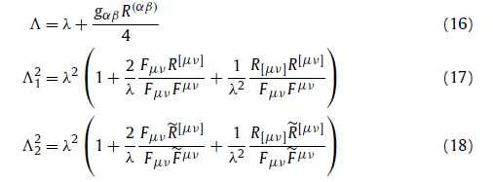
Geometrical Lagrangians: the generalized Born–Infeld action

Slide 9
If the induced structure from the tangent space Tp(M) (via Ambrose–Singer theorem) is intrinsically related to a (super)manifold structure, we have seen that there exists a transformation (Weyl, 1952;Cirilo-Lombardo, 2015)
(with A, B....generally a multi-index) having the same form as the blocks inside of the square root proposed Lagrangian (19) wherethe Poisson structure is evident (as the dual of the Lie algebra of the group manifold) in our case leading the identification between the group structure of the tan-gent space with the space–time curvature as
DJCL, Int.J.Theor.Phys. 54 (2015) no.10, 3713-3727

Slide 10
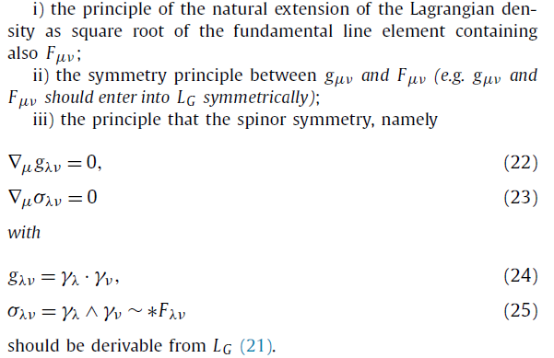
Field equations
The last principle is key because it states that the spinor invariance of the fundamental space-time structure should be derivable from the dynamic symmetries given by (21). The fact that the LG satisfies the 3 principles shows also that it has the simpler form. Notice that the action density proposed by Einstein in his nonsymmetric field theory satisfies i) and ii) but not iii).

Slide 11
δgLG

Slide 12
1) The eq. (31) is trace-free type, consequently the trace of the third term of the above equation ( that is the cosmological one ) is equal to zero. This happens trivially if = 0 or
2) b takes the place of limiting parameter (maximum value) for the electromagnetic field strength.
3)b is not a constant in general, in sharp contrast with the Born-Infeld or string theory cases.
4) Because b is the ratio involving both curvature scalars from the contrac-
tions of the generalized Ricci tensor: it is preponderant when the symmetrical contraction of R is greater than the skew one.
5) The fact pointed out in ii), namely that the curvature scalar plays the role as some
limiting parameter of the field strength, was conjectured by (Mansouri 1976) in the context of gravity theory over group manifold (generally with symmetry breaking). In such a case, this limit was established after the explicit integration of the internal group-valuated variables that is not our case here.

Slide 13
6) In similar form that the Eddington conjecture: R(αβ)∝ gαβ, we have a condition over the ratios as follows: R(αβ) /Rs ∝ gαβ/ D
7) The equations are the simplest ones when (β=0), taking the exact “quasilinear” form
this particular case (e.g. projective invariant) will be used through this work. Notice that when (β=0)all terms into the gravitational equation involving the pseudoscalar invariant,vanishes

Slide 14
δfLG

Slide 15
EMERGENT TRACE FREE GRAVITATIONAL EQUATIONS

Slide 16
Tracing the first expression in (40) we have a link the
value of the curvature and the norm of the torsion vector field. Consequently, if the dual of the torsion field have the role of the energy-matter carrier, the meaning of lambda as the vacuum energy is immediately established.
Notice that the LHS in expression (40) instead to be proportional to the metric tensor it can be proportional to the square of a Killing-Yano tensor.

Slide 18
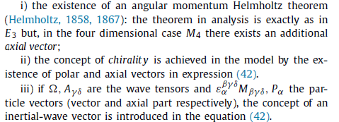
hμ and the energy–matter interpretation
the antisymmetric tensor Aγδ in the hβ composition is related with the Killing (Carter, 1968)and Killing–Yano (Yano, 1952)systems. Consequently we can introduce two types of couplings into the Aγδ divergence: it correspond with the generalized cur-rent interpretation that also has hμ.

Slide 19
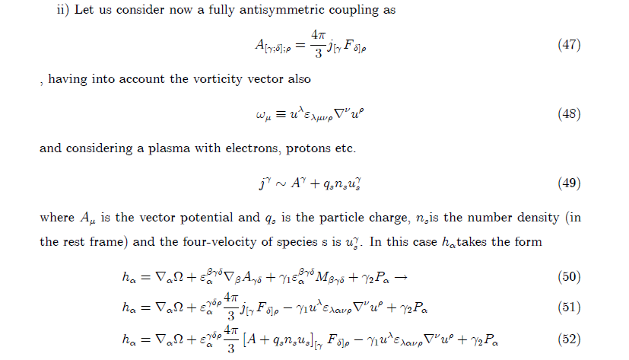

Slide 20
3+1 structure
The above expression will be very important, in particular to discuss magnetogenesis and particle generation
Notice the important fact that the symmetry of the vorticity can be associated to a 2-form bivector

Slide 21
Physical consequences
A. Electrodynamic structure in 3+1
B. Dynamo effect and geometrical origin of term

Slide 22
C. The generalized Lorentz force

Slide 23
D. Generalized current and α-term

Slide 24
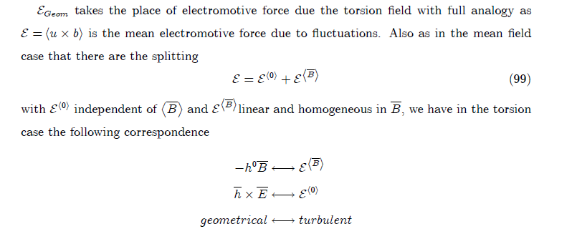
Comparison with the mean field formalism

Slide 25
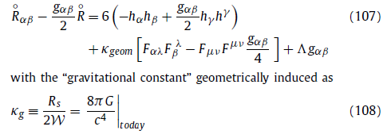
Magnetic helicity generation and cosmic torsion field
We consider the projective invariant case: β=0 (RA=−4λ) where the gravitational and field equations are considerably simplified .Scalar curvature R and the torsion 2-form field with a SU(2)-Yang–Mills structure are defined in terms of the affine connection and the SU(2)valuated (structural torsion potential)
From the last equation for the totally antisymmetric Torsion 2-form, the potential faμ define the connection.
Can be interpreted as a prototype of gauge theories interacting with gravity (e.g.QCD, GUTs, etc.).
All the fundamental constants are really geometrically induced as required by the Mach principle.

Slide 26
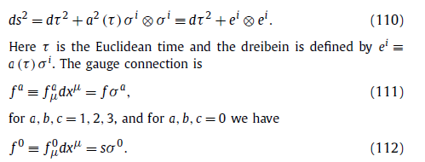
the field equation for the torsion 2-form in differential form
We are going to seek for a classical solution of (107)and (109)with the following ansatz for the metric and gauge connection

Slide 28
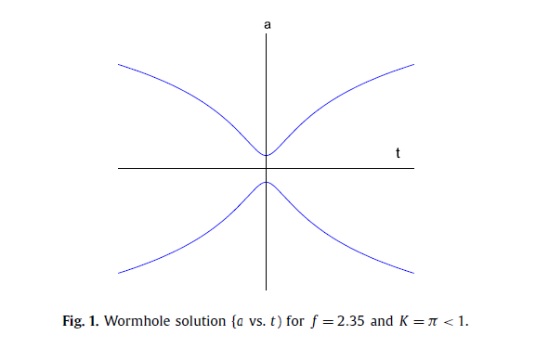

Slide 29
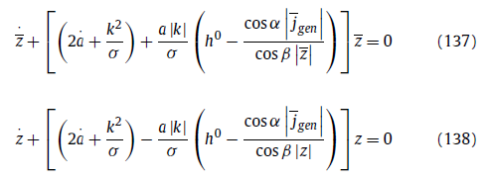
Magnetogenesis and cosmic helicity II
In the case to include the complete alpha term given by equations
and in the same analytical conditions (e.g.: Fourier de-composition) , the torsion-modified dynamic equations for the expanding FRW become
where in this case the magnetic field is written (by convenience) in terms of complex variable zas

Slide 30
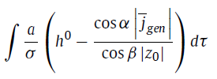
The solution in this case
there are not a definite polarization for the magnetic field, :

Slide 31
Replacing explicitly hαfrom the decomposition we can see, the interplay between the physical entities,
The above expression it is very important because establishes the desired connection between helicities, magnetic field and fermionic fields and axion.
We now clearly see the link between the axion and the fermionic fields (the dynamics of the interacting fields and the involved currents) in the LHS and the macroscopic physical observables in the RHS giving an indication of the origin of leptogenesis and baryoge-nesis in the context of this non-Riemannian gravitational model.

Slide 32
Phenomenological issues: axion mass limits
Cirilo-Lombardo, D.J., 2013. Astropart. Phys. 50–52, 51. arXiv:1310.4924
( Generalization of Bethe, H., 1935. Proc. Camb. Philol. Soc. 31, 108)
The highest helicity spin-flip cross-sectional values presented in , Journal of High Energy Astrophysics 13–14 (2017) 10–16 coincide with a recent estimation on the axion mass computed in the framework of finite temperature extended lattice QCD and under cosmological considerations (Borsanyi, S., et al., 2016. Nature 539, 69. arXiv:1606.07494.)

Slide 33
DJCL, Alvarez-Castillo and Zamora Saa, Journal of High Energy Astrophysics 13–14 (2017) 10–16

Slide 34
Discussion and perspectives
The functional action proposed, that is as square root or measure, the dynamic equations were derived: an equation analogous to trace free Einstein equations TFE and a dynamic equation for the torsion (which was taken totally antisymmetric).
The physically admissible analysis of the torsion vector hμ, from the point of view of the symmetries, has allowed us to see how matter fields can be introduced in the model. These fields include some dark matter candidates such as axion, right neutrinos and Majorana. Also the vorticity can be included in the same way and, as the torsion vector is connected to the magnetic field, both vorticity and magnetic field can be treated with equal footing.
The other point is that from the wormhole solution in a cosmological spacetime with torsion we show that primordial cosmic magnetic fields can be originated by the dual torsion field hμ being the axion field contained in hμ, the responsible to control the dynamics and stability of the cosmic magnetic field, but is not responsible of the magnetogenesis itself. Also the energy conditions in the wormhole solution are fulfilled.
The last important point to highlight is that the dynamic torsion field hμ acts as mechanism of the reduction of an original (early, primordial) GUT (Grand Unified Theory) symmetry of the universe containing ∼SU(3)×SU(2)R ×SU(2)L ×U(1) to SU(3)×SU(2)L ×U(1) today. Consequently, the GUT candidates are S O(10), SU(5) or some exceptional groups as E(6), E (7) for example.

